Slide 1
IMSE/CIS 381 Industrial Robotics
LAB 1
Program Creating and Frame Setup
Lab Instructor: Gabriele Galli
Email: ggalli@umich.edu

Slide 2
OBJECTIVES
The main objective of this experiment is to operate Fanuc robots and implement a script through the teach pendant.
Define basic concepts of tool frame as well as user frame and know how to use each frame for a specific purpose.

Slide 3
Lab Tasks
Power up and jog the robot in Joint/World.
Create a Program on the teach pendant.
Tool frame, user frame setup.

Slide 4
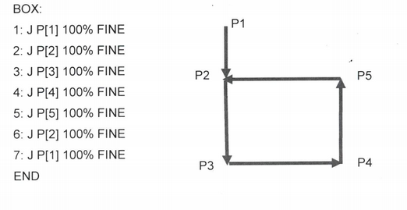
Task 1: Create a Program
Name the program: IMSE381Lab1
Use world frame.
Sketch the position with the x, y and z coordinate on a paper.
Implement the code in the teach pendant.

Slide 5
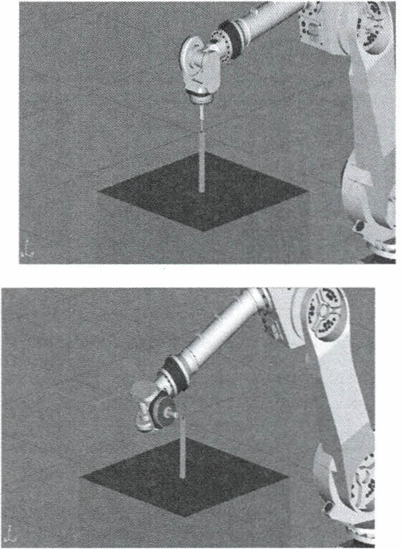
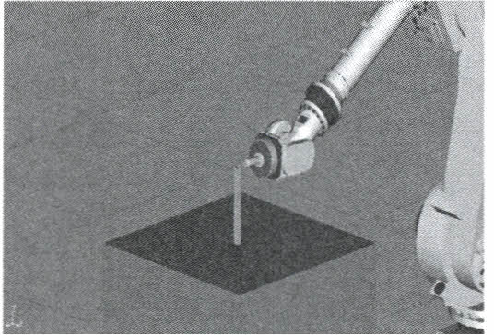
Task 2: Define a Tool Frame
A tool frame decides the trajectory that will be taken by the tool of the Fanuc robot.
The three points method is used in this module.

Slide 6
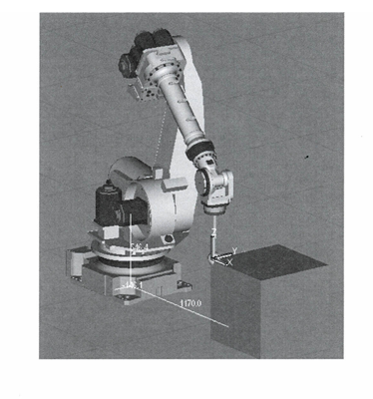
Task 3: Define a User Frame
A user frame decides the trajectory that will be taken by the Fanuc robot. Instead of using the traditional x, y and z axis, we will be using a user defined x, y and z axis.
The three points method is used in this module.

Slide 7
Report Structure
Cover Page
Abstract
Table of content
Introduction
Objective
Background
Methodology
Lab 1
Summary of the procedures.
Comment on the program in the first part.
User frame and tool frame.
Lab 2
Summary of the procedures.
Your group’s shape program.
Pictures of the drawn shapes.
Discussion & Conclusion (what you learnt in your own words)
References

Slide 8
Any Questions?

